Slide 1
Building Applications for Ofﬁce 365 and SharePoint with Angular 2
Scot Hillier
scot@scothillier.net
@ScotHillier

Slide 2
Agenda
Dev Tools and Resources
Angular 2 Framework
Site Pages
Add-Ins
SharePoint Framework

Slide 3
Development Environment
Visual Studio
Visual Studio 2017 version 15.2
https://www.visualstudio.com/downloads/
TypeScript 2.2 http://www.typescriptlang.org/
Node
Node.js 6.10.3 https://nodejs.org/en/

Slide 4
Angular 2 Framework
Fundamentals

Slide 5
Introducing Angular 2
Description
Single-Page Application (SPA) Framework
Implements MV* (pronounced M-V-star) Pattern
Why Angular
True framework instead of patchwork of libraries
Strong separation of concerns
Why Angular 2
Significant improvements in speed
Supports latest JavaScript innovations like components, modules
Better mobile support

Slide 6
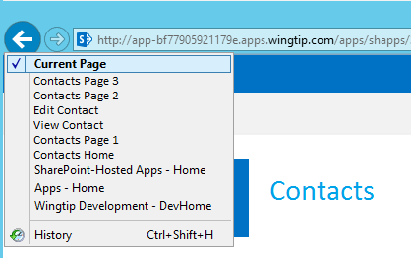
Single-Page Applications
App has one page
Different views are loaded dynamically
Routes are used to simulate pages
History list reflects route navigation
Id
First Name
Last Name
Id
1
First Name
Scot
Contacts.html
Last Name
Hillier

Slide 7
MV* with Angular 2
View
Component
Data
Model

Slide 8
Angular Building Blocks
Modules and Barrels
Components and Directives
Templates and Binding
Services and Dependency Injection

Slide 9
Modules and Barrels
//module
export class Welcome {
public static getMessage() {
return 'Hello, World!';
}
}
custom module
import module
//component
import {Welcome} from './app.module'
import {Component} from '@angular/core'
Import barrel

Slide 10
import {Welcome} from './app.module'
import {Component} from '@angular/core'
@Component({
selector: 'app-main',
template: `<h1>${Welcome.getMessage()}</h1>`
})
export class AppComponent { }
Component associates HTML template with CSS selector
<tr *ngFor="let item of items">
<td>{{item.Title}}</td>
<td>{{item.Body}}</td>
</tr>
Structural directive adds elements to DOM
Attribute directive alters existing elements
<div [(ngModel)]="welcomeMessage"></div>

Slide 11
Important Built-in Directives
ngModel: binds component data to view
ngFor: for-each loop data binding
ngIf: conditional data binding
ngSwitch: switch-case data binding
ngStyle, ngClass: styles an HTML element

Slide 12
DEMO
Hello, Angular 2

Slide 13
Site Pages

Slide 14
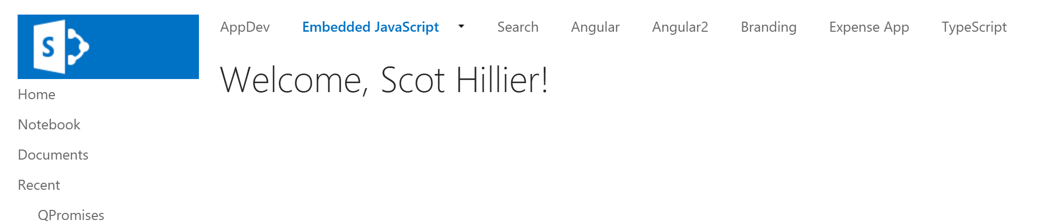
Site Page
<%@ Register TagPrefix="asp" Namespace="System.Web.UI" Assembly="System.Web.Extensions, Version=4.0.0.0, Culture=neutral, PublicKeyToken=31bf3856ad364e35" %>
<%@ Register TagPrefix="WebPartPages" Namespace="Microsoft.SharePoint.WebPartPages" Assembly="Microsoft.SharePoint, Version=15.0.0.0, Culture=neutral, PublicKeyToken=71e9bce111e9429c" %>
<%@ Import Namespace="Microsoft.SharePoint" %>
<%@ Assembly Name="Microsoft.Web.CommandUI, Version=15.0.0.0, Culture=neutral, PublicKeyToken=71e9bce111e9429c" %>
<asp:Content ID="PageHead" ContentPlaceHolderID="PlaceHolderAdditionalPageHead" runat="server">
<script type="text/javascript" src="/_layouts/15/sp.runtime.js"></script>
<script type="text/javascript" src="/_layouts/15/sp.js"></script>
<script src="https://code.angularjs.org/2.0.0-beta.0/angular2-polyfills.min.js"></script>
<script src="https://cdnjs.cloudflare.com/ajax/libs/es6-shim/0.34.1/es6-shim.min.js"></script>
<script src="https://code.angularjs.org/2.0.0-beta.0/Rx.umd.js"></script>
<script src="https://code.angularjs.org/2.0.0-beta.0/angular2-all.umd.min.js"></script>
</asp:Content>
<asp:Content ID="Main" ContentPlaceHolderID="PlaceHolderMain" runat="server">
</asp:Content>
<asp:Content ID="PageTitle" ContentPlaceHolderID="PlaceHolderPageTitle" runat="server">
Angular 2 Site Page
</asp:Content>
<asp:Content ID="PageTitleInTitleArea" ContentPlaceHolderID="PlaceHolderPageTitleInTitleArea" runat="server">

Slide 15
Sandbox Solutions
SharePoint 2013
Deprecated for use with code
Should only be used with
declarative CAML elements
Sandbox
CAML

Slide 16

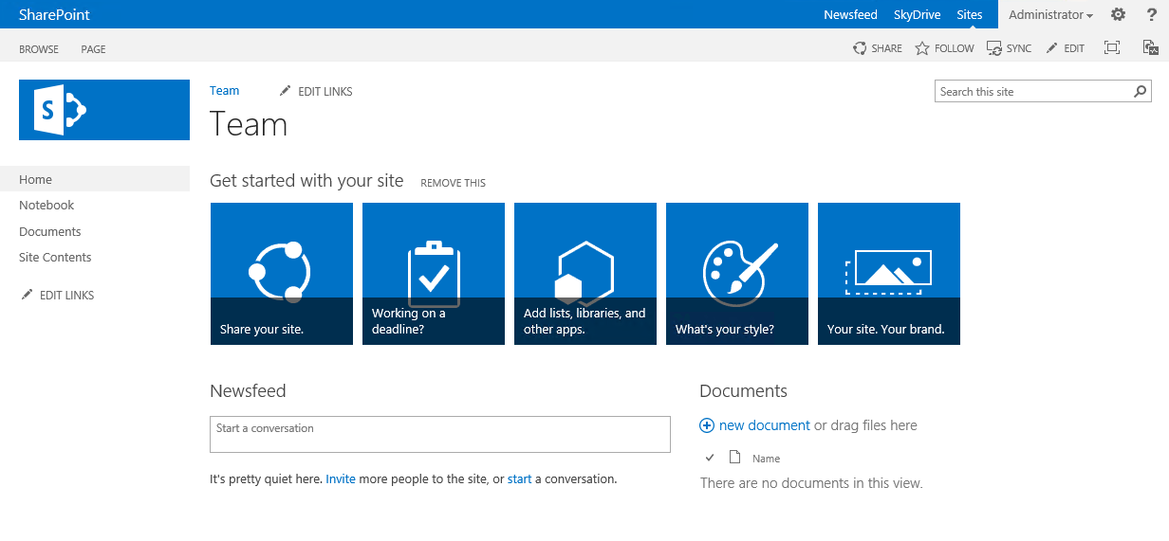
Sandbox Single-Page Application
SharePoint 2013
js
JS

Slide 17
DEMO
Site Page

Slide 18
Add-Ins

Slide 19
SharePoint-Hosted Add-In
SharePoint 2013
Host Web
App Web
Web Services

Slide 20
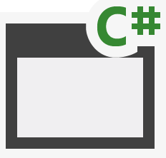
Provider Hosted Add-In (cloud)
SQL Azure
Azure Web Sites
Azure Data Market
aspx
png
master
CSS
js
SharePoint Online
Host Web
App Web

Slide 21
Provider Hosted Add-In (on-premises)
Internet Information Server
Databases
Web Services
aspx
png
master
CSS
js
SharePoint 2013
Host Web
App Web

Slide 22
DEMO
SharePoint-hosted add-in

Slide 23
SharePoint framework
Client Web Part Basics

Slide 24
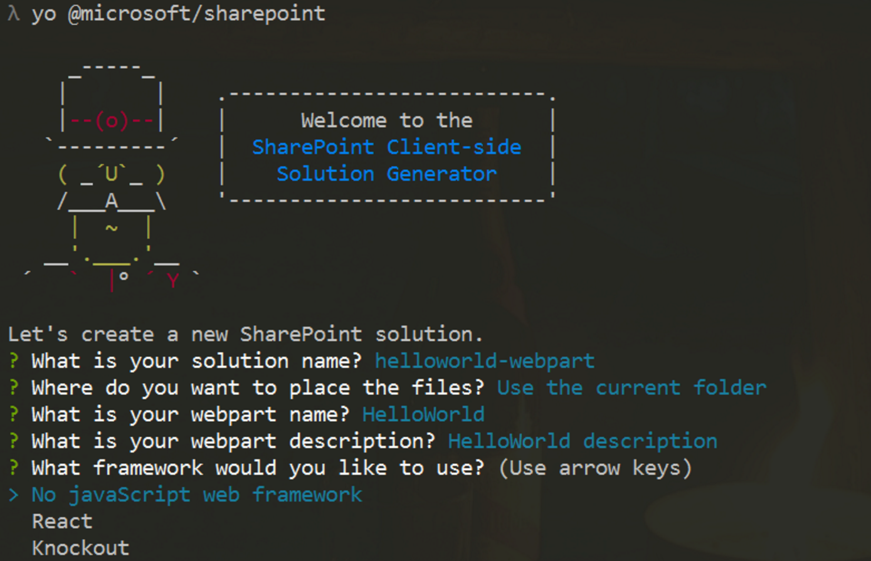
New Project Creation
Yeoman Generator
Creates initial project files
React and KO built-in
Angular 2 requires manual steps
yo @microsoft/sharepoint
Visual Studio 2015
Open created project for editing

Slide 25
Extending the BaseClientSideWebPart
export default class MyFirstKoWebPartWebPart extends
BaseClientSideWebPart<IMyFirstKoWebPartWebPartProps> {}

Slide 26
Rendering the WebPart
public render(): void {
}

Slide 27
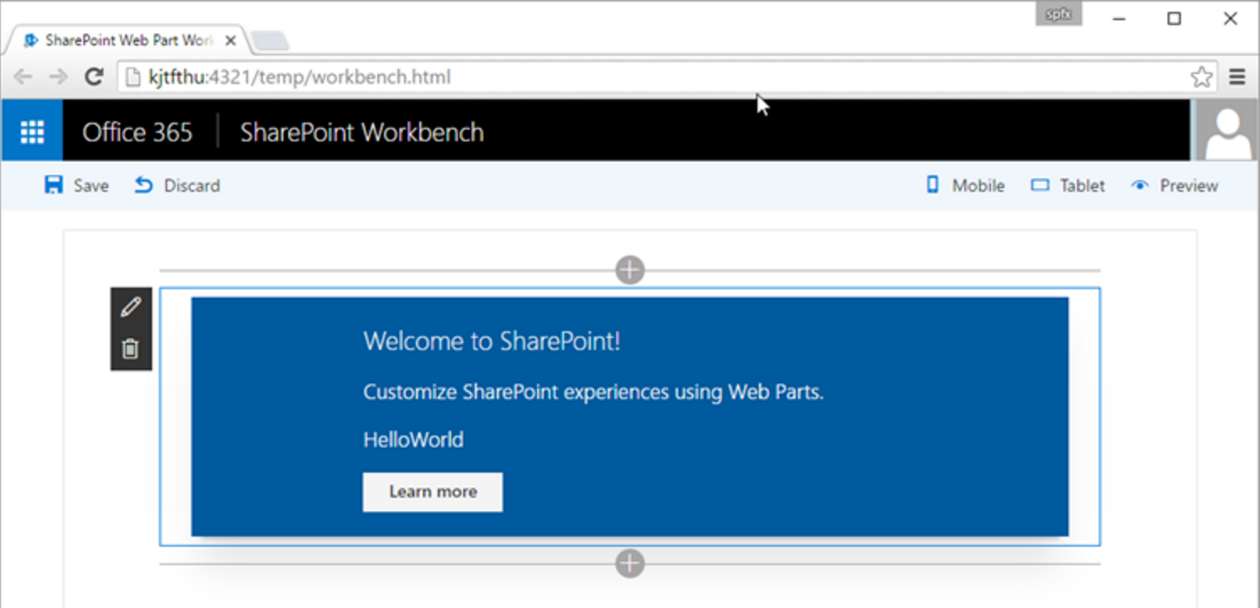
SharePoint Workbench
Local
For local testing
Office 365
Runs in the SharePoint context

Slide 28
Deployment
SharePoint
Create SPAPP package
Upload to App Catalog
Add to Site
CDN Support
Deploy assets to Azure or Document Library
Reference in WebPart

Slide 29
DEMO
Client Web Parts

Slide 30
Summary
Dev Tools and Resources
Angular 2 Framework
Site Pages
Add-Ins
SharePoint Framework

Slide 31
Questions?
Please use Events XD (EventBoard) to fill out a session evaluation.
Thank you!

